Slide 1
Assisted Reproductive Technology (ART)
Infertility

Slide 2
ART
Infertility
  Inability to conceive after 1 year of unprotected and regular sexual intercourse
Primary infertility
  Couples have never had children
Secondary infertility
  Couples initiated conception in the past and then had difficulty

Slide 3
ART
USA women infertility rate
  Ages 20-24: 4.1%
  Ages 25-29: 5.5%
  Ages 30-34: 9.4%
  Ages 35-39: 19.7%
80% of infertility cases can be diagnosed
85% of cases can be successfully treated

Slide 4
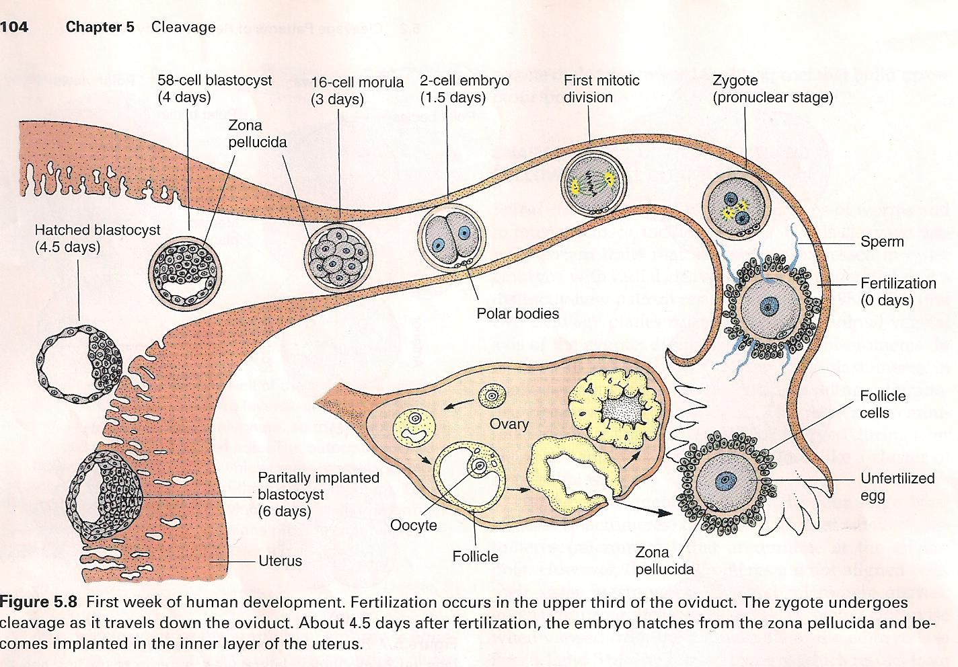
Intrauterine Insemination
Sperm sample deposited in uterus just before release of an oocyte (s) in a natural or stimulated cycle using a Soft catheter
Give hCG at injection or up to 24 hrs later
Sperm volume: 0.2-0.3 ml
Pregnancy rates
  Around 15% per cycle

Slide 5
ART
Female infertility
  Disorders of ovulation: 27%
  Fallopian tube disorders: 22%
  Pelvic adhesions: 12%
  Endometriosis: 5% to 15%
  Hyperprolactinemia: 7%

Slide 6
Male Infertility: Semen Quality
Pyospermia: Pus in the seminal fluid associated with chronic prostatitis
Asthenospermia: Reduced sperm motility
Azoospermia: Seminal fluid contains no sperm
Hypospadias: Congenital disorder of the urethra where the urinary opening is not in its normal place
Aspermia: complete lack of semen
Oligospermia: Few spermatozoa in semen
Teratospermia: Sperm with abnormal morphology
Hyperspermia: Large semen volume
Hypospermia: small semen volume
Necrospermia: Dead or immobile sperm

Slide 7
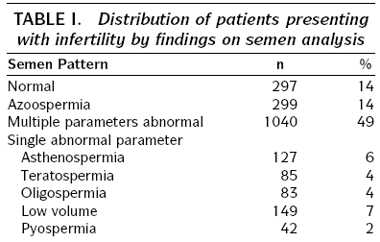
Male Infertility
Total
2104
100

Slide 8
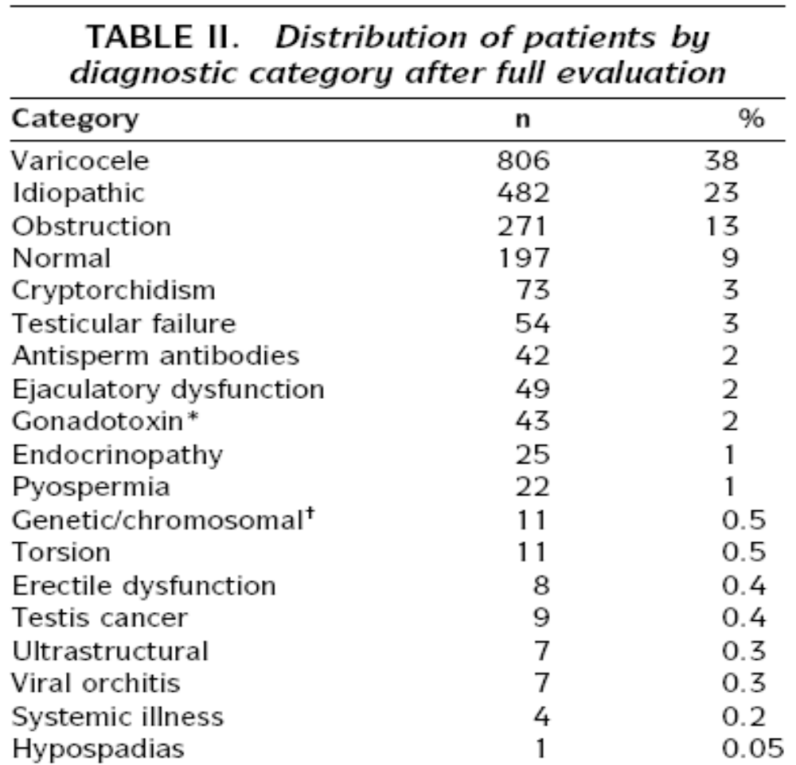
Male Infertility

Slide 9
The meaning of some terminologies in the previous table
Varicocele: An enlargement of the veins within the loose bag of the skin that holds the testicles
Idiopathic: Of unknown cause
Obstruction; or obstructive azoospermia: It is the absence of sperm in the male ejaculate despite normal spermatogenesis. Vasectomy is the most cause of vassal obstruction. Severe genitourinary infections and congenital anomalies are other common causes of obstruction.
Cryptorchidism: A condition in which one or both of the testis fail to descend from the abdomen into the scrotum of the testis.
Testicular failure: Occurs when testicles cannot produce sperm or male hormones, such as testosterone.
Ejaculatory dysfunction; Is the inability of a man to efficiently ejaculate semen from the penis at the moment of sexual climax. It can be resulted from medications, certain chronic health conditions and surgeries. Or it might be caused substance misuse or mental health concern as well as depression and stress.

Slide 10
Continue
Endocrinopathy: A disease or a problem of an endocrine gland such as hyperthyroidism and hypothyroidism.
Viral orchitis: Is an inflammation of one or both testicles. Bacterial of viral infections can cause orchitis.
Hypospadias: is a condition in which the opening of the urethra is on the underside of the penis instead of at the tip.
Erectile dysfunction is the inability to get or keep an erection firm enough to have sexual intercourse. It is sometimes referred to as impotence. Many men experience this problem during times of stress.

Slide 11
ART
Assisted Conception

Slide 12
Assisted Conception
Techniques designed to assist couples in their effort to procreate
Reason
  Identification and correction of female, male or a combination of both infertility causes

Slide 13
Assisted Conception
Objective
  To bring sperm and oocyte close to each other to promote chances of fertilization and, ultimately, achieve a pregnancy

Slide 14
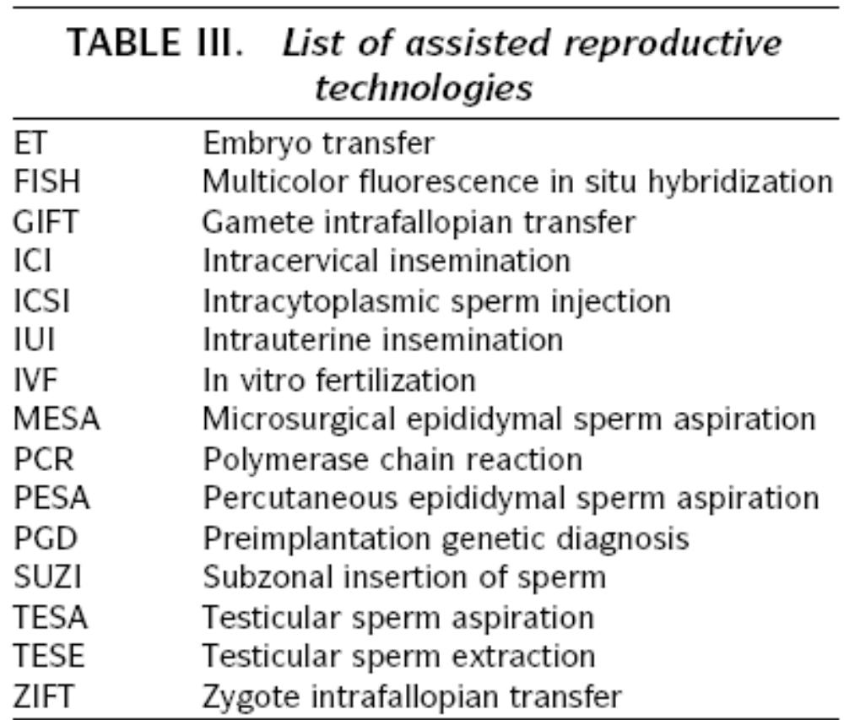










Slide 15
Assisted Conception
Required procedures
  Superovulation
  Sperm preparation
  Assisted fertilization

Slide 16
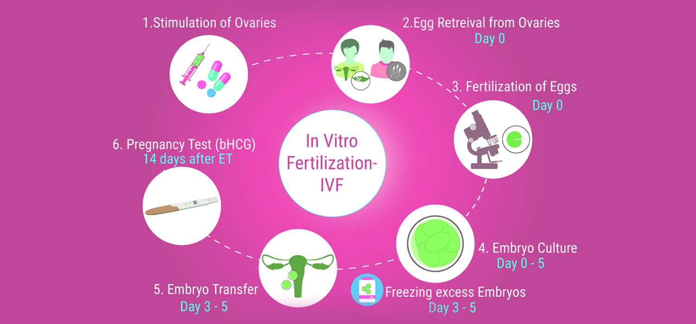
Summary of IVF

Slide 17
Superovulation
Hormonal manipulation to enhance ovulation and release multiple oocytes during ovulatory cycle

Slide 18
Superovulation
Drugs used:
Human menopausal gonadotropin
  Taken from urine of postmenopausal women
  Follicle stimulating hormone (FSH) and luteinizing hormone (LH) activity
Recombinant FSH
Recombinant LH

Slide 19
Superovulation- protocol
Gonadotropin for 9-11 days
Monitoring follicular development by transvaginal ultrasound
Follicles 16 -18 mm in diameter
  10,000 IU hCG
    Oocytes maturation
    Ovulation

Slide 20
Sperm Preparation
Select PMNS (Progressively motile normal sperm)
Remove seminal plasma, WBC, and bacteria
Sperm capacitation
  Coating of sperm with seminal plasma proteins
  Allow sperm to become fertile
  In vivo or in test tube

Slide 21
